Slide 1

R Programming Language
Josip Šaban
30.11.2012

Slide 2
Outline
What is analytics?
What is R and how people use it?
Advantages and limitations
Support and resources
Ways to run R
Enterprise versions
Demo

Slide 3
What is analytics?

Slide 4
What is analytics?
Statistics +
Machine Learning +
Artificial Intelligence…
Used to explain or predict information
Business analytics software: $10.5 billion in 2010
+ Service + Hardware = $50 billion
Growing 13.5%/year

Slide 5
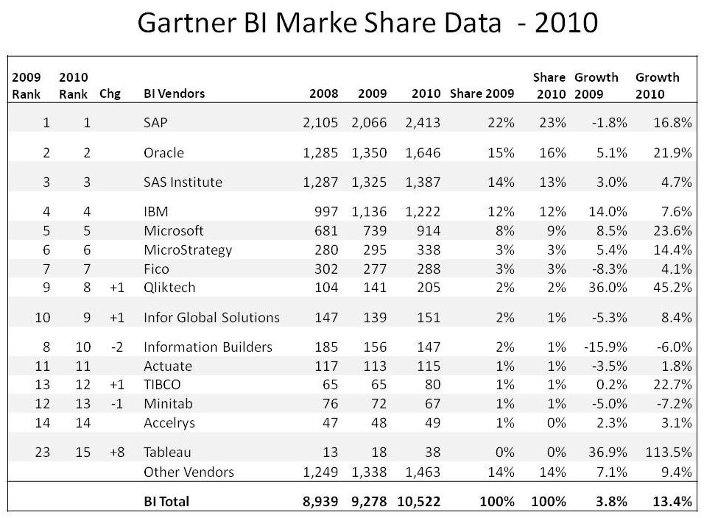
Business inteligence

Slide 6
What is R and how people use it?

Slide 7
What is R?
Open source statistical language
And no, it is not about the money!
De facto standard for statistical research
Grew out of Bell Labs’ S (1976, 1988)
Licensed by AT&T/Lucent to Insightful Corp. Product name: S-plus.

Slide 8
What is R?
Language + package + environment for graphics and data analysis
Free and open source
Created by Ross Ihaka & Robert Gentleman 1996 & extended by many more
An implementation of the S language by John Chambers and others
R has roughly ( year 2012 ) 5000 add-ons and about 100,000 functions

Slide 9
“Open source”... that just means I don’t have to pay for it, right?
„Free” is NEVER an advantage
Provides full access to algorithms and their implementation
Gives you the ability to fix bugs and extend software
Provides a forum allowing researchers to explore and expand the methods used to analyze data
Is the product of 1000s of leading experts in the fields they know best - it is CUTTING EDGE

Slide 10
“Open source”... that just means I don’t have to pay for it, right?
Ensures that scientists around the world - and not just ones in rich countries - are the co-owners to the software tools needed to carry out research
Promotes reproducible research by providing open and accessible tools
Most of R is written in… R! This makes it quite easy to see what functions are actually doing

Slide 11
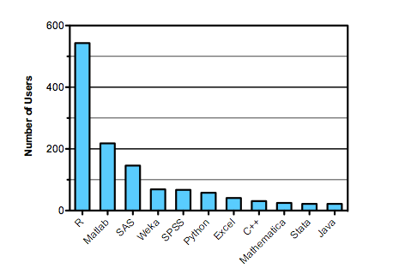
R in data analysis
Languages used in Kaggle.com data analysis competition 2011 Source: http://r4stats.com/popularity

Slide 12
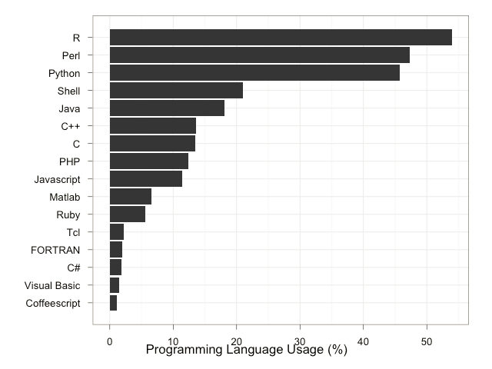
R in bioinformatics (2012)
http://bioinfsurvey.org/analysis/programming_languages/

Slide 13
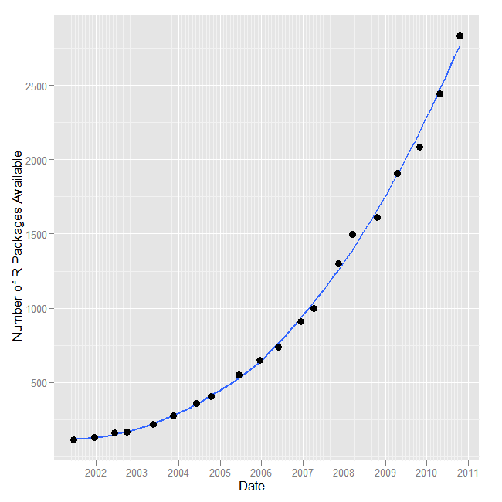
Growth in R addon packages
Source: r4stats.com/popularity

Slide 14
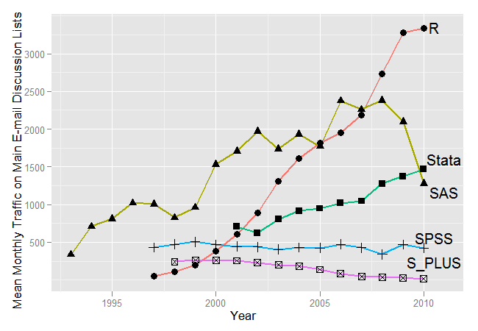
Growth in Internet Discussion
Source: r4stats.com/popularity

Slide 15
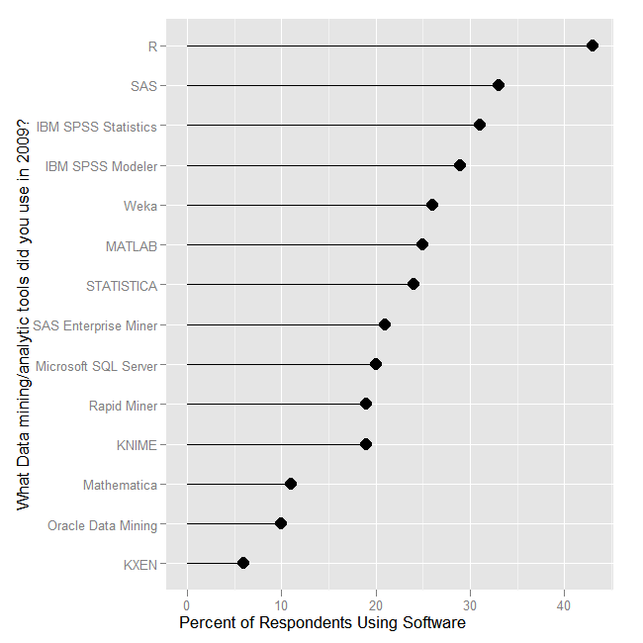
Rexer Analytics Poll on “tools”

Slide 16
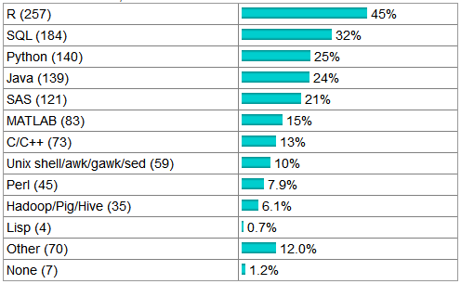
KDnuggests.com Poll on “languages”

Slide 17

Drew Conway/John Myles White
“… R has a unique and somewhat prickly syntax and tends to have a steeper learning curve than other languages.”

Slide 18

What about speed?
Maybe 100x slower than C++, though it varies greatly.

Slide 19

What about tool support?
Limited compared to, for example, first release of Visual Studio (1995).

Slide 20
Domain-specific language ( DSL )
To understand a DSL, start with D, not L.
The alternative to R isn’t Python or C#, it’s SAS.
People love their DSL, and will use it outside of its domain.
“The best thing about R is that it was written by statisticians. The worst thing about R ...” Bo Cowgill, Google

Slide 21
What are statisticians like?
Different priorities than software developers
Different priorities than mathematicians
Learn bits of R in parallel with statistics

Slide 22
What is a statistical DSL?
Statistical functions easily accessible
Convenient manipulation of tables
Vector operations
Smooth handling of missing data
Patterns for common tasks

Slide 23
Advantages of R
A powerful programming language
Designed for interactive data analysis
Easier to program than, e.g., SAS
Open source, interpreted, portable
Succinct notation for querying and filtering
Succinct notation for linear regression
Commands are written in that language

Slide 24
Advantages of R
Commands are visible and changeable
Commands you write that are on equal footing
Output that easily becomes input
Models easily applied to new data
Legions of developers, thousands of add-ons
Internet archives make add-ons easy to find

Slide 25
R’s Limitations
Must find R and its add-ons yourself
Documentation is sparse & complex
Graphical user interfaces not as polished
Language is somewhat harder to learn
Most R functions hold data in main memory
Notes:
R 32-bit: ~5 million values
R 64-bit: depends on how much memory you have
SAS/SPSS: billions of records
Several efforts underway to break R’s memory limit

Slide 26
What about accuracy?
Base R plus Recommended Packages like:
Base SAS, SAS/STAT, SAS/GRAPH, SAS/IML Studio
SPSS Stat. Base, SPSS Stat. Advanced, Regression
Tested via extensive validation programs
But add-on packages written by…
Professor who invented the method?
A student interpreting the method?

Slide 27
What about tech-support?
Email support is free, quick, 24-hours: https://stat.ethz.ch/mailman/listinfo/r-help
You may get “too much” help
Phone support available commercially e.g. Revolution Analytics
Use http://www.rseek.org/ instead of Google

Slide 28
Add-on packages
Alphabetical list at: http://cran.r-project.org
Use any search engine: “neural network” + “R package”
Crantastic.org

Slide 29
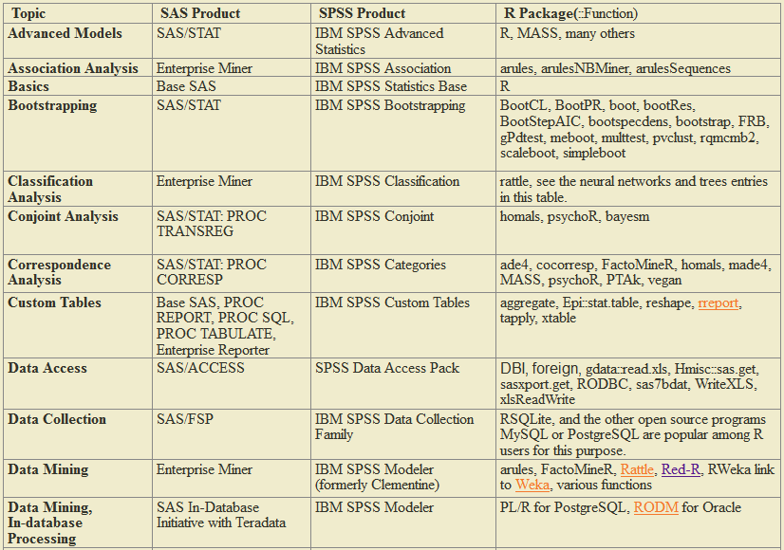
Add-on packages
http://r4stats.com/add-ons

Slide 30


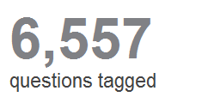
Relevant sites
quora.com/R-software
stackoverflow.com/questions/tagged/r

Slide 31
Relevant sites
R wiki:
http://rwiki.sciviews.org/doku.php
R graph gallery:
http://addictedtor.free.fr/graphiques/thumbs.php
Kickstarting R:
http://cran.r-project.org/doc/contrib/Lemon-kickstart/

Slide 32
Ways to run R

Slide 33
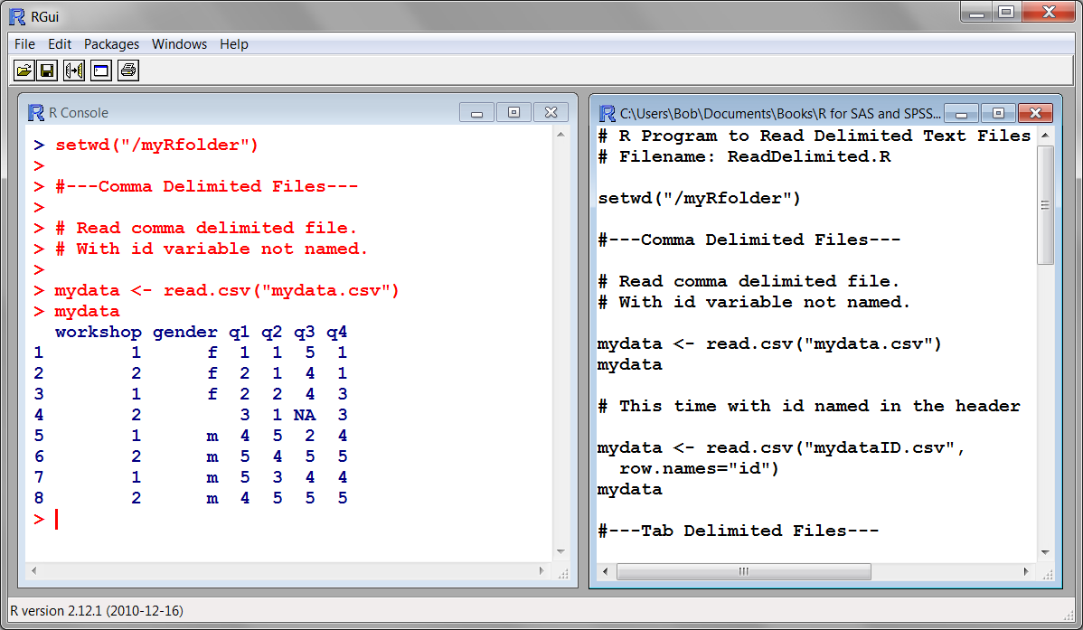
Standard Windows Interface

Slide 34
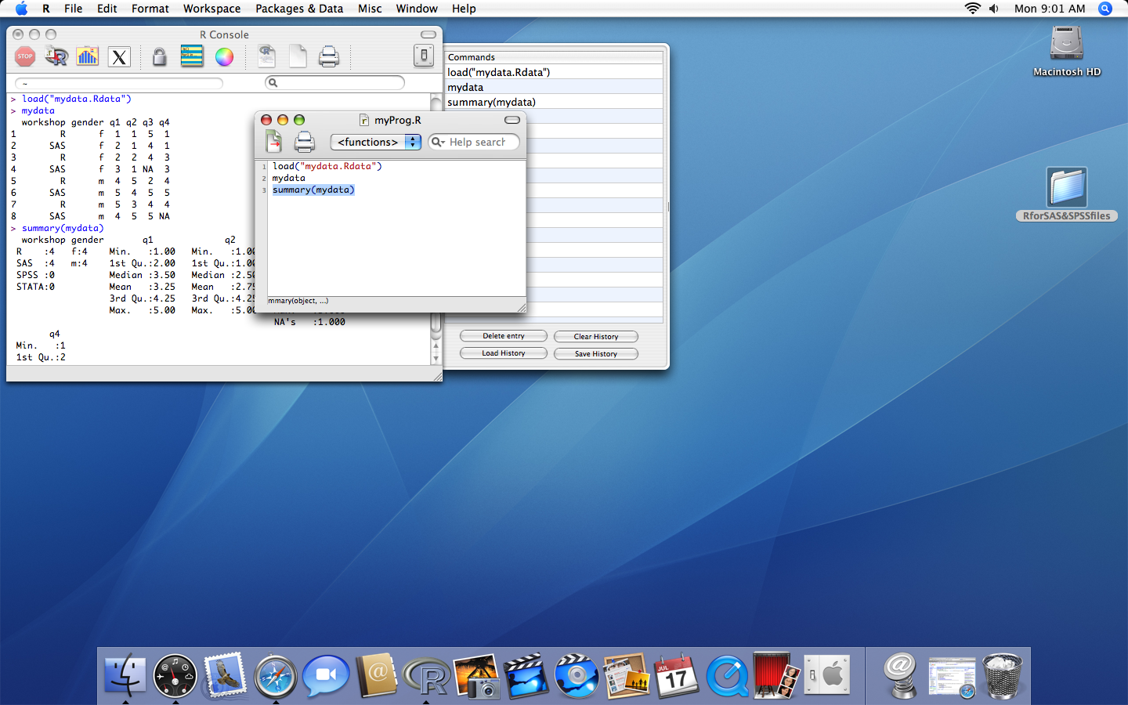
Standard MacIntosh interface

Slide 35
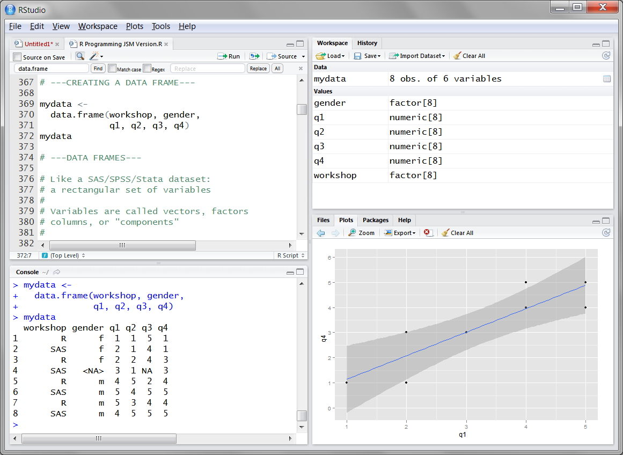
RStudio ( http://RStudio.org )

Slide 36
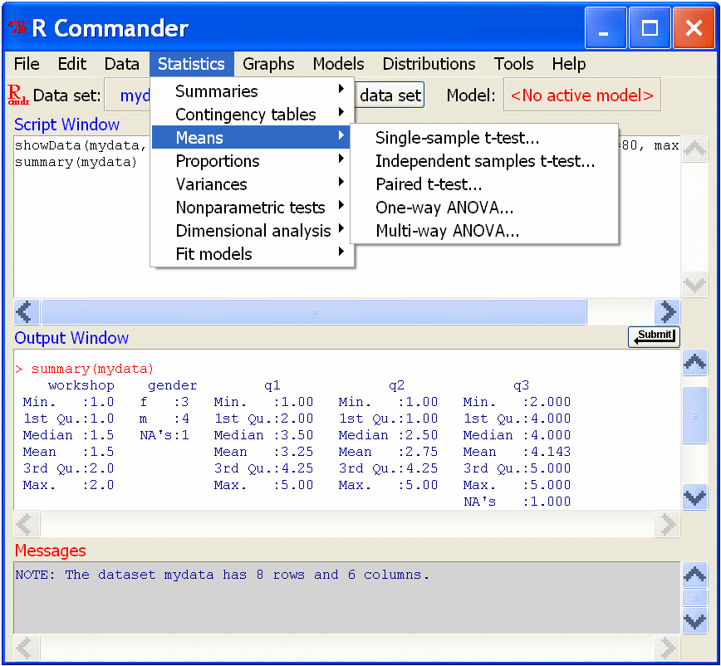
R Commander

Slide 37
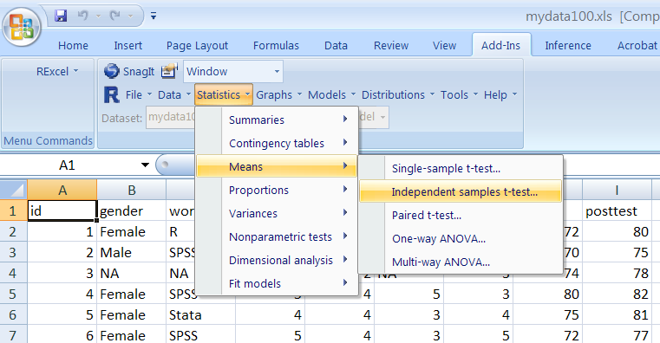
Running R from Excel

Slide 38
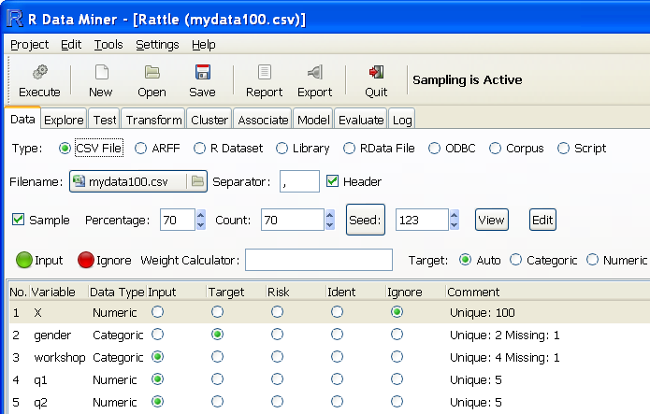
Rattle: R Analytical Tool To Learn Easily

Slide 39
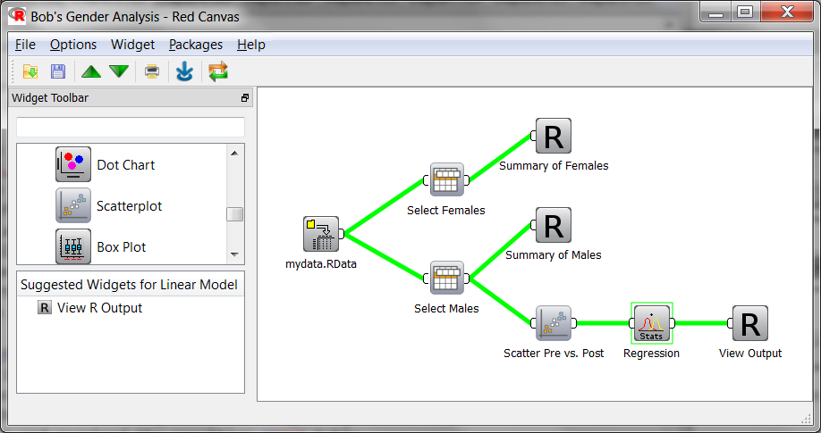
Red-R ( http://www.red-r.org/ )

Slide 40
Revolution R Enterprise
From Revolution Analytics
Company run by SPSS founders Norman Nie and “Tex” Hull
Recompiled for speed using optimized compilers
Supports multi-core processors
ParallelR for clusters
Includes R Productivity Environment

Slide 41
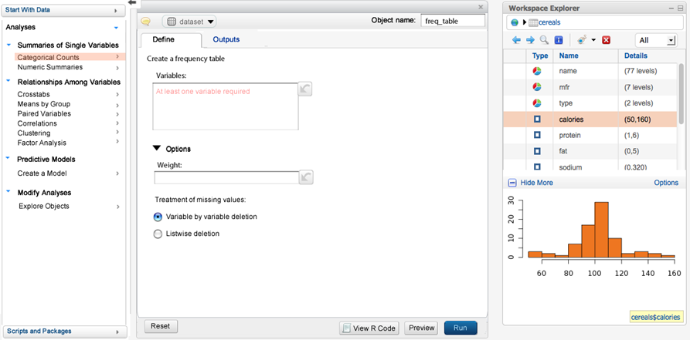
Revolution Analytics User Interface

Slide 42
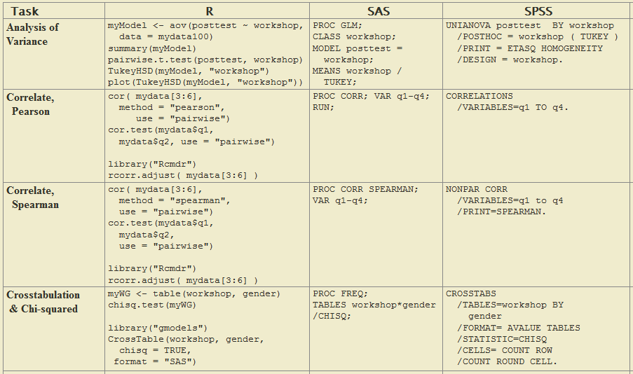
Code comparison

Slide 43
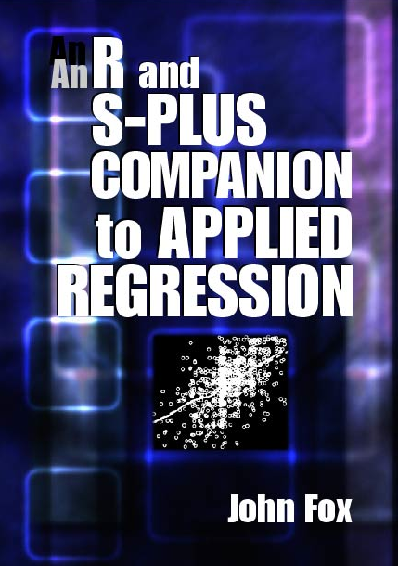
1st recommended book
An R and S-PLUS Companion to Applied Regression: An excellent overview of R, not just regression in R. Highly recommended.

Slide 44
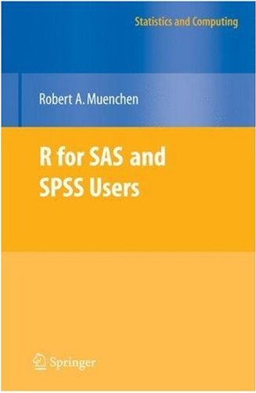
2nd recommended book
R for SAS and SPSS Users: This book is geared to people who already know SAS or SPSS and want to learn R. If that describes you, you might consider buying this book.

Slide 45
A few more books
R for Stata Users, Muenchen & Hilbe
R Through Excel: A Spreadsheet Interface for Statistics, Data Analysis, and Graphics, Heiberger & Neuwirth
Data Mining with Rattle and R: The Art of Excavating Data for Knowledge Discovery, Williams

Slide 46
Demo

Slide 47
Design of the R system
The R system is divided into 2 conceptual parts:
The “base” R system
Everything else
R functionality is divided into a number of packages

Slide 48
Design of the R system
The “base” R system contains, among other things, the base package which is required to run R and contains the most fundamental functions
The other packages contained in the “base” system include utils, stats, datasets, graphics, grDevices, grid, methods, tools, parallel, compiler, splines, tcltk, stats4

Slide 49
Design of the R system
And there are many other packages available
There are also many packages associated with the Bioconductor project ( http://bioconductor.org )
People often make packages available on their personal websites; there is no reliable way to keep track of how many packages are available in this fashion

Slide 50
Demo requirements
Software
RStudio ( http://www.rstudio.com/ide/ )
Source files
http://web.mit.edu/tkp/www/R/R_Tutorial_Data.txt
http://web.mit.edu/tkp/www/R/R_Tutorial_Inputs.txt

Slide 51
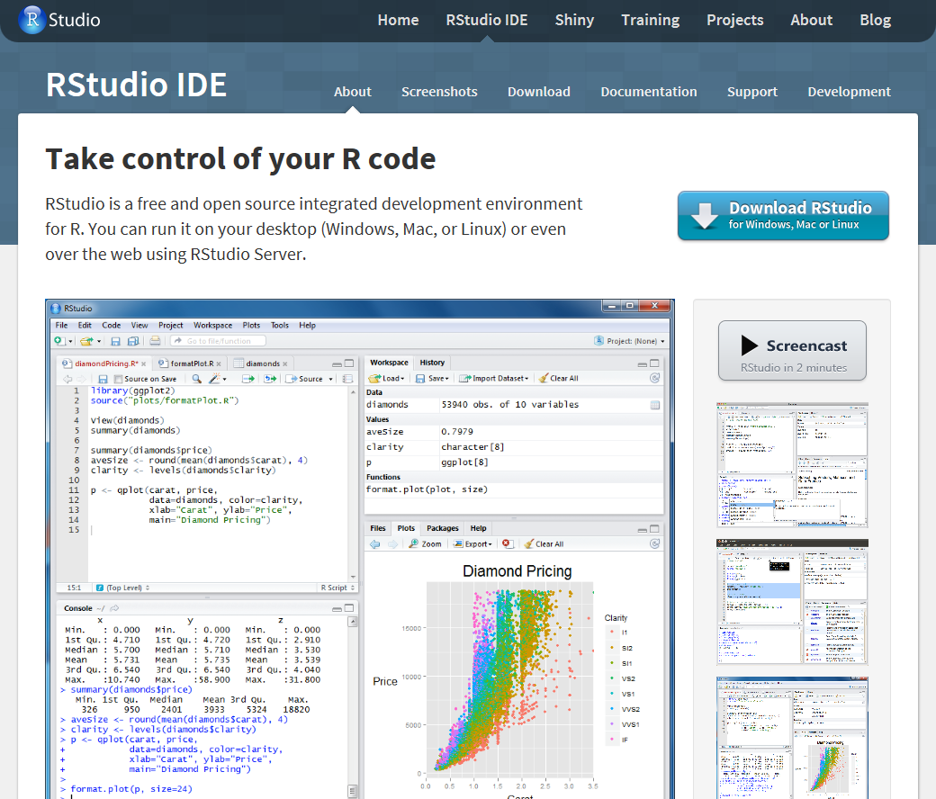
RStudio

Slide 52
Demo
Entering data
Math, Variables, Arrays
Math on arrays
Functions
Getting help
Reading data from files
Selecting subsets of data

Slide 53
Demo
Math:
Variables:
> 1 + 1
[1] 2
> 1 + 1 * 7
[1] 8
> (1 + 1) * 7
[1] 14
> x <- 1
> x
[1] 1
> y = 2
> y
[1] 2
> 3 -> z
> z
[1] 3
> (x + y) * z
[1] 9

Slide 54
Demo
Arrays:
> x <- c(0,1,2,3,4)
> x
[1] 0 1 2 3 4
> y <- 1:5
> y
[1] 1 2 3 4 5
> z <- 1:50
> z
[1] 1 2 3 4 5 6 7 8 9 10 11 12 13 14 15
[16] 16 17 18 19 20 21 22 23 24 25 26 27 28 29 30
[31] 31 32 33 34 35 36 37 38 39 40 41 42 43 44 45
[46] 46 47 48 49 50

Slide 55
Demo
Math on arrays:
> x <- c(0,1,2,3,4)
> y <- 1:5
> z <- 1:50
> x + y
[1] 1 3 5 7 9
> x * y
[1] 0 2 6 12 20
> x * z
[1] 0 2 6 12 20 0 7 16 27 40 0
[12] 12 26 42 60 0 17 36 57 80 0 22
[23] 46 72 100 0 27 56 87 120 0 32 66
[34] 102 140 0 37 76 117 160 0 42 86 132
[45] 180 0 47 96 147 200

Slide 56
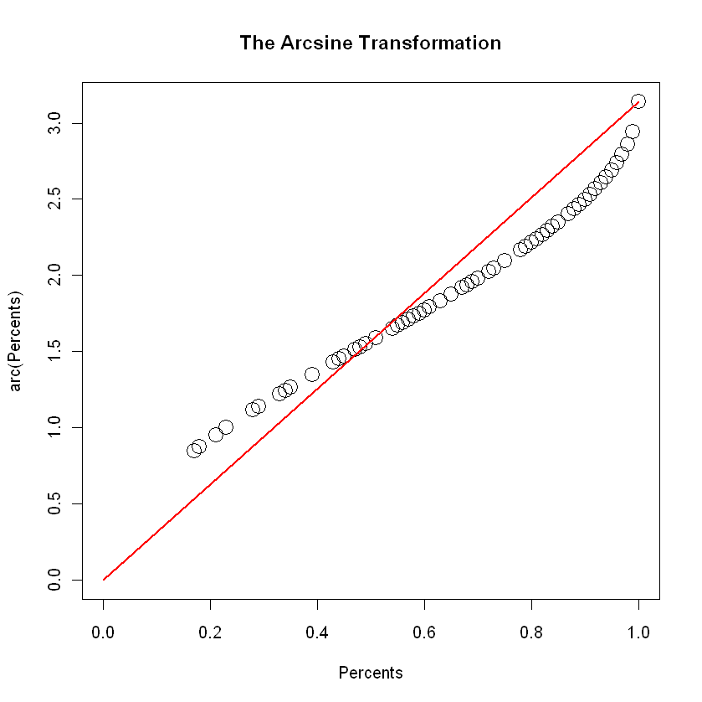
Demo
Functions:
> arc <- function(x) 2*asin(sqrt(x))
> arc(0.5)
[1] 1.570796
> x <- c(0,1,2,3,4)
> x <- x / 10
> arc(x)
[1] 0.0000000 0.6435011 0.9272952
[4] 1.1592795 1.3694384
> plot(arc(Percents)~Percents,
+ pch=21,cex=2,xlim=c(0,1),ylim=c(0,pi),
+ main="The Arcsine Transformation")
> lines(c(0,1),c(0,pi),col="red",lwd=2)

Slide 57
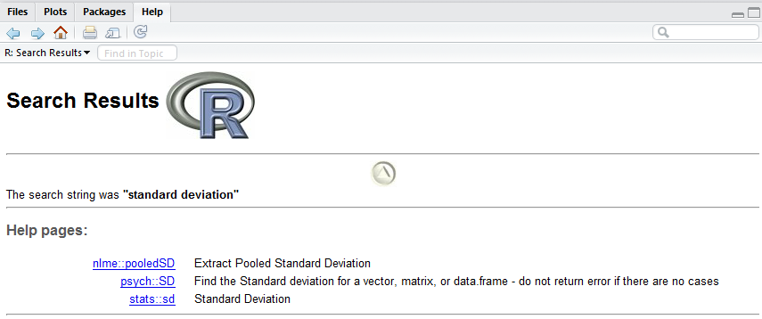
Demo
Getting help:
> help(t.test)
> help.search("standard deviation")

Slide 58
Demo
Example experiment:
Subjects learning to perform a new task:
Two groups of subjects
(“A” and “B”; high and low aptitude learners)
Two types of training paradigm
(“High variability” and “Low variability”)
Four pre-training assessment tests
Example data in “R_Tutorial_Data.txt”

Slide 59
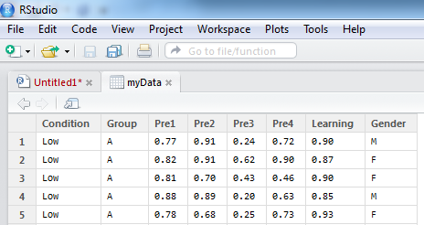
Demo
Reading data from files:
> myData <- read.table("R_Tutorial_Data.txt",
+ header=TRUE, sep="\t")
> myData
Condition Group Pre1 Pre2 Pre3 Pre4 Learning
1 Low A 0.77 0.91 0.24 0.72 0.90
2 Low A 0.82 0.91 0.62 0.90 0.87
3 Low A 0.81 0.70 0.43 0.46 0.90
. . .
61 High B 0.44 0.41 0.84 0.82 0.29
62 High B 0.48 0.56 0.83 0.85 0.48
63 High B 0.61 0.82 0.88 0.95 0.28

Slide 60
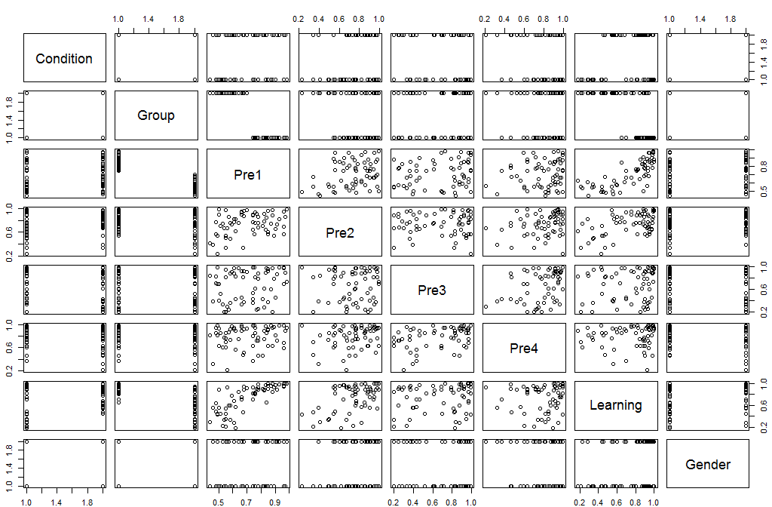
Demo
Examining datasets:
> plot(myData)

Slide 61
Demo
Selecting subsets of data:
> myData$Learning
[1] 0.90 0.87 0.90 0.85 0.93 0.93 0.89 0.80 0.98
[10] 0.88 0.88 0.94 0.99 0.92 0.83 0.65 0.57 0.55
[19] 0.94 0.68 0.89 0.60 0.63 0.84 0.92 0.56 0.78
[28] 0.54 0.47 0.45 0.59 0.91 0.98 0.82 0.93 0.81
[37] 0.97 0.95 0.70 1.00 0.90 0.99 0.95 0.95 0.97
[46] 1.00 0.99 0.18 0.33 0.88 0.23 0.75 0.21 0.35
[55] 0.70 0.34 0.43 0.75 0.44 0.44 0.29 0.48 0.28
> myData$Learning[myData$Group=="A"]
[1] 0.90 0.87 0.90 0.85 0.93 0.93 0.89 0.80 0.98
[10] 0.88 0.88 0.94 0.99 0.92 0.83 0.65 0.98 0.82
[19] 0.93 0.81 0.97 0.95 0.70 1.00 0.90 0.99 0.95
[28] 0.95 0.97 1.00 0.99

Slide 62
Demo
Selecting subsets of data:
> myData$Learning
[1] 0.90 0.87 0.90 0.85 0.93 0.93 0.89 0.80 0.98
[10] 0.88 0.88 0.94 0.99 0.92 0.83 0.65 0.57 0.55
[19] 0.94 0.68 0.89 0.60 0.63 0.84 0.92 0.56 0.78
[28] 0.54 0.47 0.45 0.59 0.91 0.98 0.82 0.93 0.81
[37] 0.97 0.95 0.70 1.00 0.90 0.99 0.95 0.95 0.97
[46] 1.00 0.99 0.18 0.33 0.88 0.23 0.75 0.21 0.35
[55] 0.70 0.34 0.43 0.75 0.44 0.44 0.29 0.48 0.28
> attach(myData)
> Learning
[1] 0.90 0.87 0.90 0.85 0.93 0.93 0.89 0.80 0.98
[10] 0.88 0.88 0.94 0.99 0.92 0.83 0.65 0.57 0.55
[19] 0.94 0.68 0.89 0.60 0.63 0.84 0.92 0.56 0.78
[28] 0.54 0.47 0.45 0.59 0.91 0.98 0.82 0.93 0.81
[37] 0.97 0.95 0.70 1.00 0.90 0.99 0.95 0.95 0.97
[46] 1.00 0.99 0.18 0.33 0.88 0.23 0.75 0.21 0.35
[55] 0.70 0.34 0.43 0.75 0.44 0.44 0.29 0.48 0.28

Slide 63
Demo
Selecting subsets of data:
> Learning[Group=="A"]
[1] 0.90 0.87 0.90 0.85 0.93 0.93 0.89 0.80 0.98
[10] 0.88 0.88 0.94 0.99 0.92 0.83 0.65 0.98 0.82
[19] 0.93 0.81 0.97 0.95 0.70 1.00 0.90 0.99 0.95
[28] 0.95 0.97 1.00 0.99
> Learning[Group!="A"]
[1] 0.57 0.55 0.94 0.68 0.89 0.60 0.63 0.84 0.92
[10] 0.56 0.78 0.54 0.47 0.45 0.59 0.91 0.18 0.33
[19] 0.88 0.23 0.75 0.21 0.35 0.70 0.34 0.43 0.75
[28] 0.44 0.44 0.29 0.48 0.28
> Condition[Group=="B"&Learning<0.5]
[1] Low Low High High High High High High High
[10] High High High High High
Levels: High Low

Slide 64
Demo - Statistics and Data Analysis
Parametric Tests
Independent sample t-tests
Paired sample t-tests
One sample t-tests
Correlation
Nonparametric tests
Shapiro-Wilks test for normality
Wilcoxon signed-rank test (Mann-Whitney U)
Chi square test
Linear Models and ANOVA

Slide 65
Basic parametric inferential statistics
Independent sample t-tests:
> t.test(Pre2[Group=="A"],
+ Pre2[Group=="B"],
+ paired=FALSE)
Welch Two Sample t-test
data: Learning[Group == "A"] and Learning[Group == "B"]
t = 1.6117, df = 53.275, p-value = 0.1129
alternative hypothesis: true difference in means is not equal to 0
95 percent confidence interval:
-0.0179193 0.1645725
sample estimates:
mean of x mean of y
0.7764516 0.7031250
http://www.wellesley.edu/Psychology/Psych205/indepttest.html
Notes:
The Independent Samples T Test compares the mean scores of two groups on a given variable.

Slide 66
Basic parametric inferential statistics
Independent sample t-tests:
> t.test(Pre2[Group=="A"],
+ Pre2[Group=="B"],
+ paired=FALSE,
+ var.equal=TRUE)
Welch Two Sample t-test
data: Learning[Group == "A"] and Learning[Group == "B"]
t = 1.601, df = 61, p-value = 0.1145
alternative hypothesis: true difference in means is not equal to 0
95 percent confidence interval:
-0.0179193 0.1645725
sample estimates:
mean of x mean of y
0.7764516 0.7031250

Slide 67
Basic parametric inferential statistics
Independent sample t-tests:
> t.test(Pre2[Group=="A"],
+ Pre2[Group=="B"],
+ paired=FALSE,
+ var.equal=TRUE,
+ alternative="greater")
Welch Two Sample t-test
data: Learning[Group == "A"] and Learning[Group == "B"]
t = 1.601, df = 61, p-value = 0.5727
alternative hypothesis: true difference in means is greater than 0
95 percent confidence interval:
-0.003169388 Inf
sample estimates:
mean of x mean of y
0.7764516 0.7031250

Slide 68
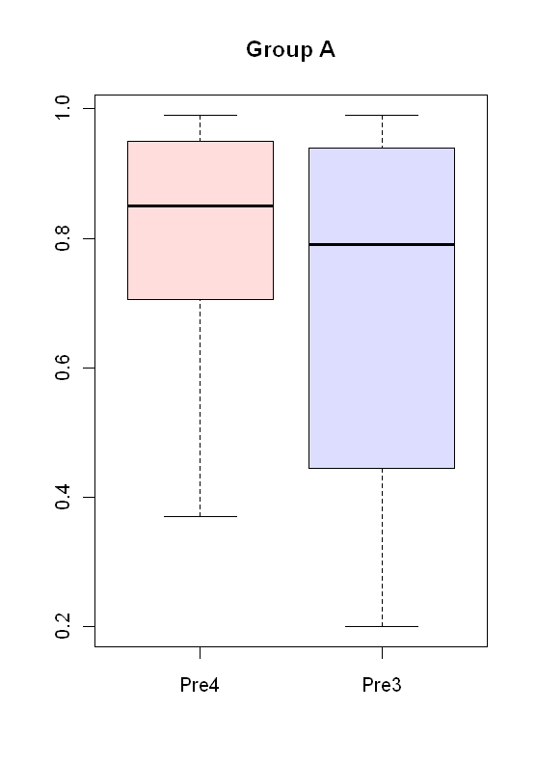
Basic parametric inferential statistics
Paired sample t-test:
> t.test(Pre4[Group=="A"],
+ Pre3[Group=="A"],
+ paired=TRUE)
Paired t-test
data: Pre4[Group == "A"] and Pre3[Group == "A"]
t = 2.4054, df = 30, p-value = 0.02253
alternative hypothesis: true difference in means is not equal to 0
95 percent confidence interval:
0.01641059 0.20100876
sample estimates:
mean of the differences
0.1087097
> boxplot(Pre4[Group=="A"],
+ Pre3[Group=="A"],
+ col=c("#ffdddd","#ddddff"),
+ names=c("Pre4","Pre3"),main="Group A")
http://www.wellesley.edu/Psychology/Psych205/pairttest.html
Notes:
The Paired Samples T Test compares the means of two variables. It computes the difference between the two variables for each case, and tests to see if the average difference is significantly different from zero.

Slide 69
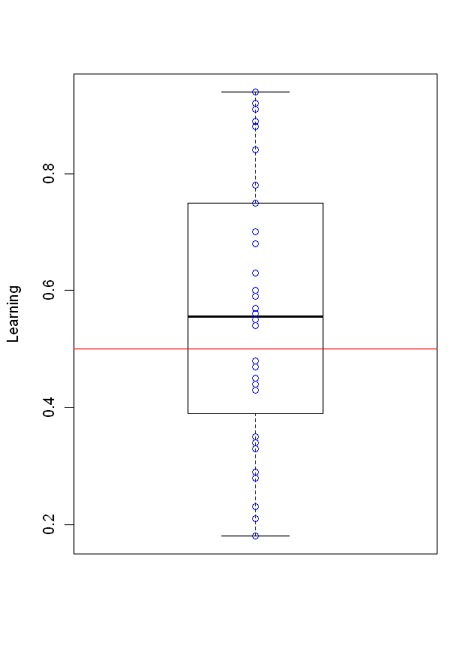
Basic parametric inferential statistics
One sample t-test:
> t.test(Learning[Group=="B"], mu=0.5, alternative="greater")
One Sample t-test
data: Learning[Group == "B"]
t = 1.5595, df = 31, p-value = 0.06452
alternative hypothesis: true mean is greater than 0.5
95 percent confidence interval:
0.4945469 Inf
sample estimates:
mean of x
0.5625
> boxplot(Learning[Group=="B"],
+ names="Group B", ylab="Learning")
> lines(c(0,2), c(0.5, 0.5), col="red")
> points(c(rep(1,length(Learning[Group=="B"]))),
+ Learning[Group=="B"], pch=21, col="blue")
http://www.wellesley.edu/Psychology/Psych205/onettest.html
Notes:
The One-Sample T Test compares the mean score of a sample to a known value. Usually, the known value is a population mean.

Slide 70
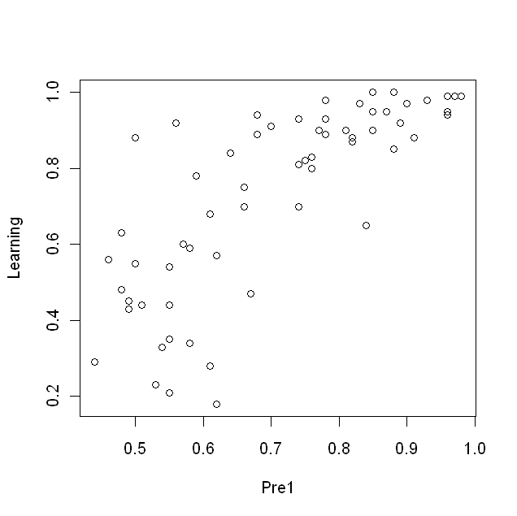
Basic parametric inferential statistics
Correlation:
> cor.test(Pre1,Learning,method="pearson")
Pearson's product-moment correlation
data: Pre1 and Learning
t = 9.2461, df = 61, p-value = 3.275e-13
alternative hypothesis: true correlation is not equal to 0
95 percent confidence interval:
0.6366698 0.8506815
sample estimates:
cor
0.7639292
> plot(Pre1,Learning)

Slide 71
Basic parametric inferential statistics
Correlation (fancier plot example):
> cor.test(Pre1,Learning,method="pearson")
Pearson's product-moment correlation
data: Pre1 and Learning
t = 9.2461, df = 61, p-value = 3.275e-13
alternative hypothesis: true correlation is not equal to 0
95 percent confidence interval:
0.6366698 0.8506815
sample estimates:
cor
0.7639292
> plot(Pre1,Learning)

Slide 72
Statistics and data analysis
Are my data normally distributed?
> t.test(Learning[Condition=="High"&Group=="A"],
+ Learning[Condition=="Low"&Group=="A"])
Welch Two Sample t-test
data: Learning[Condition == "High" & Group == "A"] and Learning[Condition == "Low" & Group == "A"]
t = 1.457, df = 28.422, p-value = 0.1561
alternative hypothesis: true difference in means is not equal to 0
95 percent confidence interval:
-0.01764821 0.10481488
sample estimates:
mean of x mean of y
0.9273333 0.8837500

Slide 73
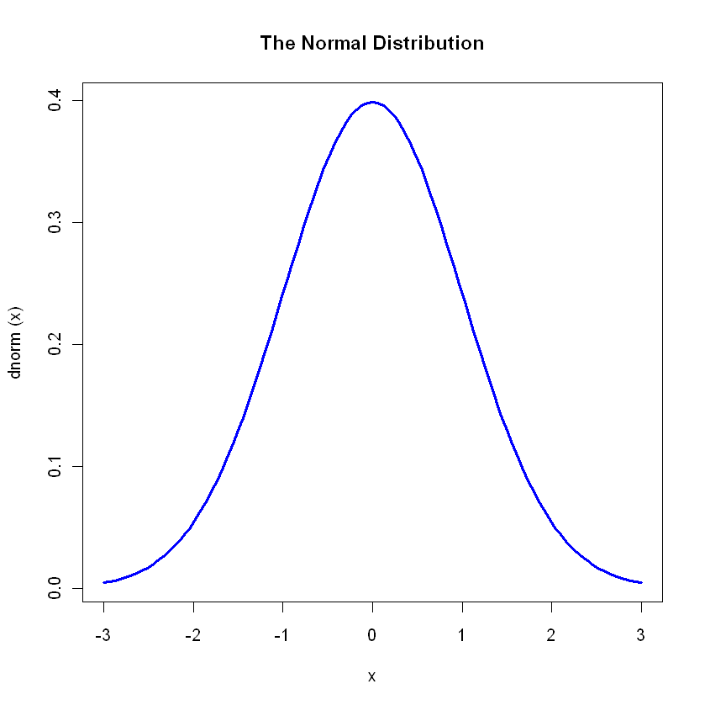
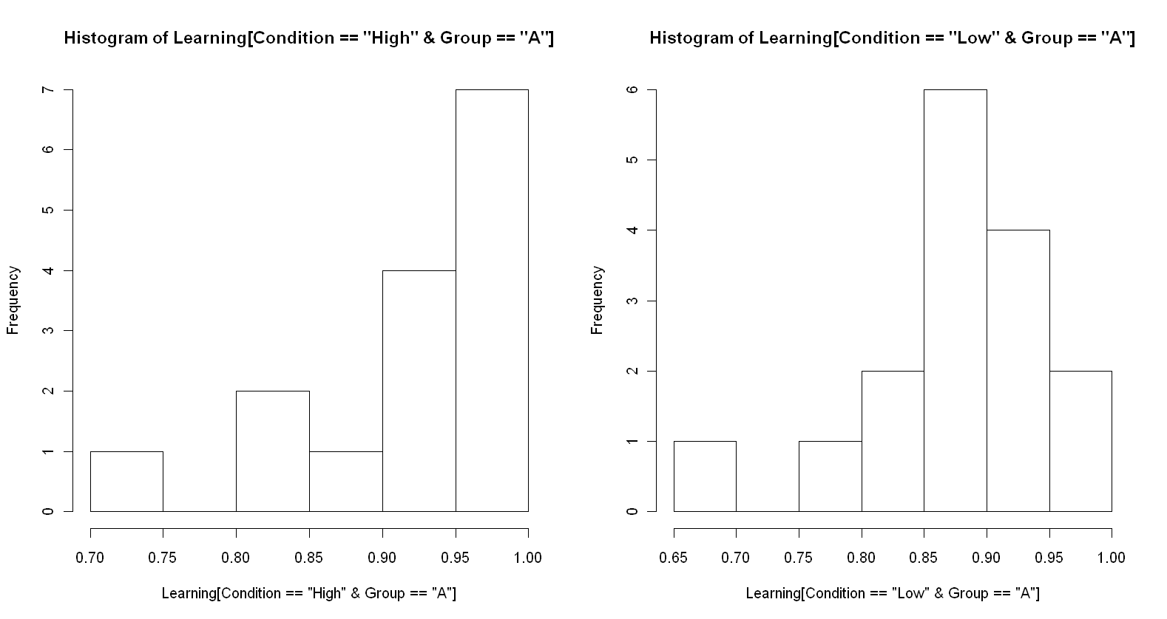
Statistics and data analysis
Are my data normally distributed?
> plot(dnorm,-3,3,col="blue",lwd=3,main="The Normal Distribution")
> par(mfrow=c(1,2))
> hist(Learning[Condition=="High"&Group=="A"])
> hist(Learning[Condition=="Low"&Group=="A"])

Slide 74
Statistics and data analysis
Are my data normally distributed?
> shapiro.test(Learning[Condition=="High"&Group=="A"])
Shapiro-Wilk normality test
data: Learning[Condition == "High" & Group == "A"]
W = 0.7858, p-value = 0.002431
> shapiro.test(Learning[Condition=="Low"&Group=="A"])
Shapiro-Wilk normality test
data: Learning[Condition == "Low" & Group == "A"]
W = 0.8689, p-value = 0.02614
http://en.wikipedia.org/wiki/Shapiro%E2%80%93Wilk_test
Notes:
In statistics, the Shapiro–Wilk test tests the null hypothesis that a sample x1, ..., xn came from a normally distributed population.

Slide 75
Basic non-parametric inferential statistics
Wilcoxon signed-rank/Mann-Whitney U tests:
> wilcox.test(Learning[Condition=="High"&Group=="A"],
+ Learning[Condition=="Low"&Group=="A"],
+ exact=FALSE,
+ paired=FALSE)
Wilcoxon rank sum test with continuity correction
data: Learning[Condition == "High" & Group == "A"] and Learning[Condition == "Low" & Group == "A"]
W = 173.5, p-value = 0.03580
alternative hypothesis: true location shift is not equal to 0
http://en.wikipedia.org/wiki/Wilcoxon_signed-rank_test
http://en.wikipedia.org/wiki/Mann%E2%80%93Whitney_U
Notes:
The Wilcoxon signed-rank test is a non-parametric statistical hypothesis test used when comparing two related samples, matched samples, or repeated measurements on a single sample to assess whether their population mean ranks differ (i.e. it is a paired difference test). It can be used as an alternative to the paired Student's t-test, t-test for matched pairs, or the t-test for dependent samples when the population cannot be assumed to be normally distributed
In statistics, the Mann–Whitney U test (also called the Mann–Whitney–Wilcoxon (MWW) or Wilcoxon rank-sum test) is a non-parametric statistical hypothesis test for assessing whether one of two samples of independent observations tends to have larger values than the other. It is one of the most well-known non-parametric significance tests.

Slide 76
Basic non-parametric inferential statistics
Chi-squared tests:
> x <- matrix(c(
+ length(Learning[Group=="A"&Condition=="High"&Gender=="F"]),
+ length(Learning[Group=="A"&Condition=="Low"&Gender=="F"]),
+ length(Learning[Group=="B"&Condition=="High"&Gender=="F"]),
+ length(Learning[Group=="B"&Condition=="Low"&Gender=="F"])),
+ ncol=2)
> x
[,1] [,2]
[1,] 4 12
[2,] 10 7
> chisq.test(x)
Pearson's Chi-squared test with Yates' continuity correction
data: x
X-squared = 2.5999, df = 1, p-value = 0.1069
http://en.wikipedia.org/wiki/Chi-squared_distribution
Notes:
In probability theory and statistics, the chi-squared distribution (also chi-square or χ²-distribution) with k degrees of freedom is the distribution of a sum of the squares of k independent standard normal random variables. It is one of the most widely used probability distributions in inferential statistics, e.g., in hypothesis testing or in construction of confidence intervals. When there is a need to contrast it with the non-central chi-squared distribution, this distribution is sometimes called the central chi-squared distribution.

Slide 77
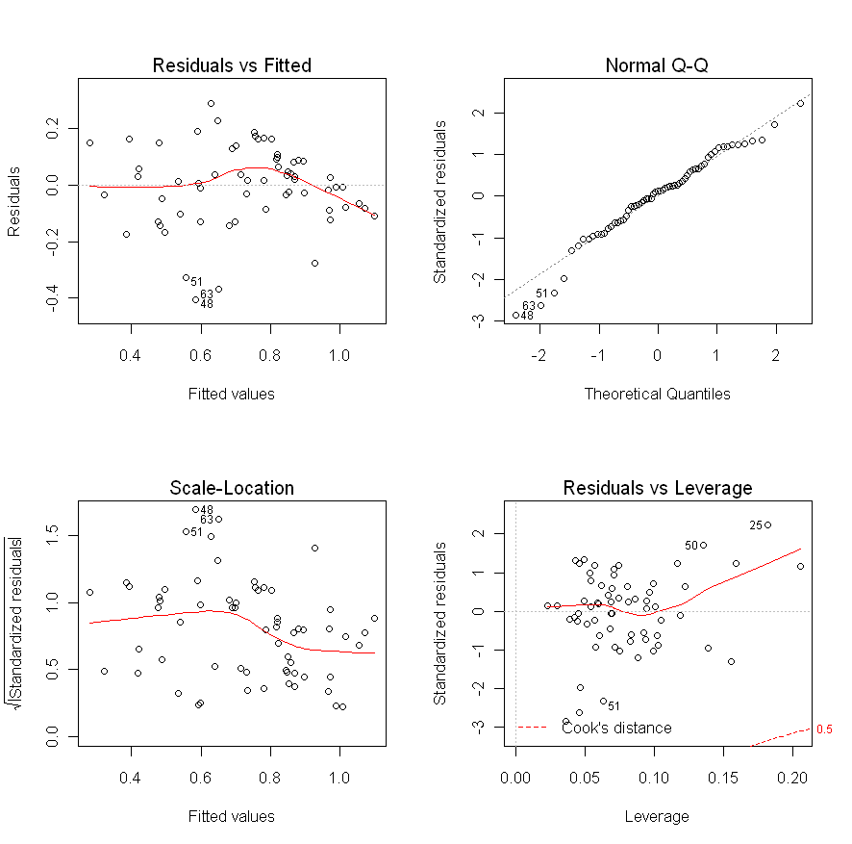
Linear models and ANOVA
Linear models:
> myModel <- lm(Learning ~ Pre1 + Pre2 + Pre3 + Pre4)
> par(mfrow=c(2,2))
> plot(myModel)
http://online.stat.psu.edu/online/development/stat501/05model_check/03model_check_rvf.html
http://en.wikipedia.org/wiki/Q%E2%80%93Q_plot
http://www.jerrydallal.com/LHSP/summary.htm
Notes:
When conducting a residual analysis, a "residuals versus fits plot" is the most frequently created plot. It is a scatter plot of residuals on the y axis and fitted values (estimated responses) on the x axis. The plot is used to detect non-linearity, unequal error variances, and outliers.
In statistics, a Q–Q plot ("Q" stands for quantile) is a probability plot, which is a graphical method for comparing two probability distributions by plotting their quantiles against each other. First, the set of intervals for the quantiles are chosen. A point (x,y) on the plot corresponds to one of the quantiles of the second distribution (y-coordinate) plotted against the same quantile of the first distribution (x-coordinate). Thus the line is a parametric curve with the parameter which is the (number of the) interval for the quantile.
After constructing graphical displays of a batch of numbers, the next thing to do is summarize the data numerically. Statistics are summaries derived from the data. The two important statistics that describe a single response are measures of location (typical value; the word location is a reference to the data's location on the number line) and spread (variability). The number of observations (the sample size, n) is important, too, but it is generally considered a "given". It is not counted as one of the summary statistics even though it fits the definition ("a function solely of the data") perfectly.

Slide 78
Linear models and ANOVA
Linear models:
> summary(myModel)
Call:
lm(formula = Learning ~ Pre1 + Pre2 + Pre3 + Pre4)
Residuals:
Min 1Q Median 3Q Max
-0.40518 -0.08460 0.01707 0.09170 0.29074
Coefficients:
Estimate Std. Error t value Pr(>|t|)
(Intercept) -0.22037 0.11536 -1.910 0.061055 .
Pre1 1.05299 0.12636 8.333 1.70e-11 ***
Pre2 0.41298 0.10926 3.780 0.000373 ***
Pre3 0.07339 0.07653 0.959 0.341541
Pre4 -0.18457 0.11318 -1.631 0.108369
---
Signif. codes: 0 ‘***’ 0.001 ‘**’ 0.01 ‘*’ 0.05 ‘.’ 0.1 ‘ ’ 1
Residual standard error: 0.1447 on 58 degrees of freedom
Multiple R-squared: 0.6677, Adjusted R-squared: 0.6448
F-statistic: 29.14 on 4 and 58 DF, p-value: 2.710e-13

Slide 79
Linear models and ANOVA
Linear models:
> step(myModel, direction="backward")
Start: AIC=-238.8
Learning ~ Pre1 + Pre2 + Pre3 + Pre4
Df Sum of Sq RSS AIC
- Pre3 1 0.01925 1.2332 -239.81
<none> 1.2140 -238.80
- Pre4 1 0.05566 1.2696 -237.98
- Pre2 1 0.29902 1.5130 -226.93
- Pre1 1 1.45347 2.6675 -191.21
Step: AIC=-239.81
Learning ~ Pre1 + Pre2 + Pre4
Df Sum of Sq RSS AIC
- Pre4 1 0.03810 1.2713 -239.89
<none> 1.2332 -239.81
- Pre2 1 0.28225 1.5155 -228.83
- Pre1 1 1.54780 2.7810 -190.58
...
...
Step: AIC=-239.89
Learning ~ Pre1 + Pre2
Df Sum of Sq RSS AIC
<none> 1.2713 -239.89
- Pre2 1 0.24997 1.5213 -230.59
- Pre1 1 1.52516 2.7965 -192.23
Call:
lm(formula = Learning ~ Pre1 + Pre2)
Coefficients:
(Intercept) Pre1 Pre2
-0.2864 1.0629 0.3627

Slide 80
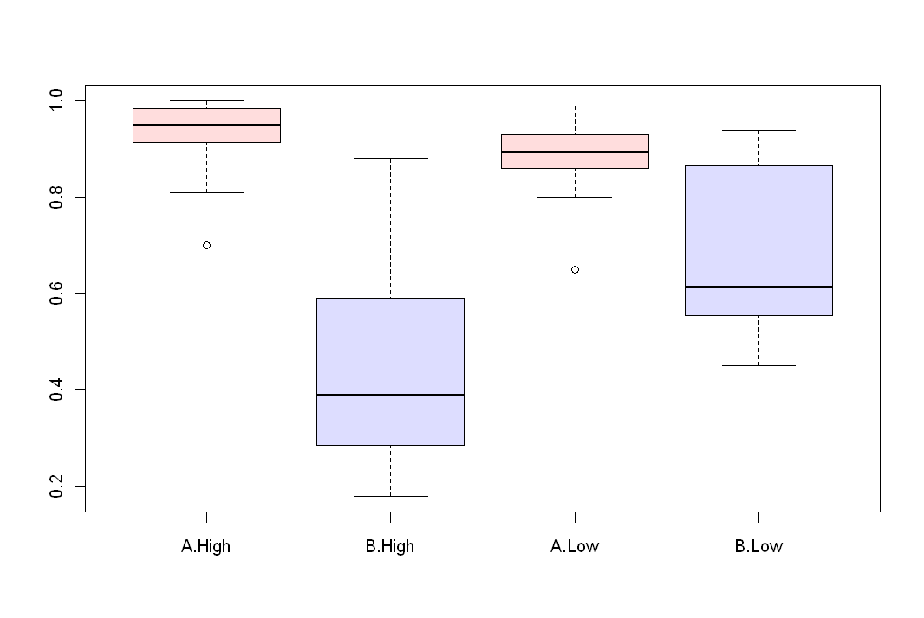
Linear models and ANOVA
ANOVA:
> myANOVA <- aov(Learning~Group*Condition)
> summary(myANOVA)
Df Sum Sq Mean Sq F value Pr(>F)
Group 1 1.8454 1.84537 81.7106 9.822e-13 ***
Condition 1 0.1591 0.15910 7.0448 0.0102017 *
Group:Condition 1 0.3164 0.31640 14.0100 0.0004144 ***
Residuals 59 1.3325 0.02258
---
Signif. codes: 0 ‘***’ 0.001 ‘**’ 0.01 ‘*’ 0.05 ‘.’ 0.1 ‘ ’ 1
> boxplot(Learning~Group*Condition,col=c("#ffdddd","#ddddff"))
http://en.wikipedia.org/wiki/Analysis_of_variance
Notes:
In statistics, analysis of variance (ANOVA) is a collection of statistical models, and their associated procedures, in which the observed variance in a particular variable is partitioned into components attributable to different sources of variation. In its simplest form, ANOVA provides a statistical test of whether or not the means of several groups are all equal, and therefore generalizes t-test to more than two groups. Doing multiple two-sample t-tests would result in an increased chance of committing a type I error. For this reason, ANOVAs are useful in comparing two, three, or more means.

Slide 81
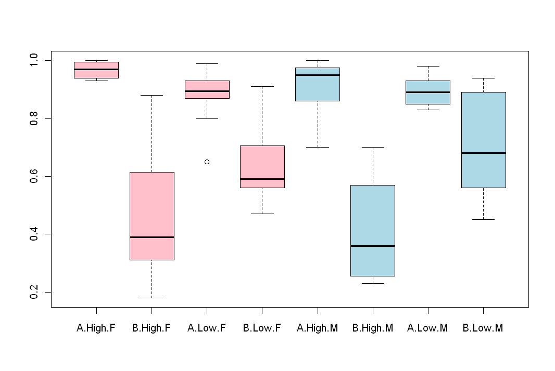
Linear models and ANOVA
ANOVA:
> myANOVA2 <- aov(Learning~Group*Condition+Gender)
> summary(myANOVA2)
Df Sum Sq Mean Sq F value Pr(>F)
Group 1 1.84537 1.84537 80.3440 1.523e-12 ***
Condition 1 0.15910 0.15910 6.9270 0.010861 *
Gender 1 0.04292 0.04292 1.8688 0.176886
Group:Condition 1 0.27378 0.27378 11.9201 0.001043 **
Residuals 58 1.33216 0.02297
---
Signif. codes: 0 ‘***’ 0.001 ‘**’ 0.01 ‘*’ 0.05 ‘.’ 0.1 ‘ ’ 1
> boxplot(Learning~Group*Condition+Gender,
+ col=c(rep("pink",4),rep("light blue",4)))

Slide 82

The End
josipsaban@gmail.com

